Slide 1

Metrocar Funnel Analysis
By Charu Kesarwani

Slide 2
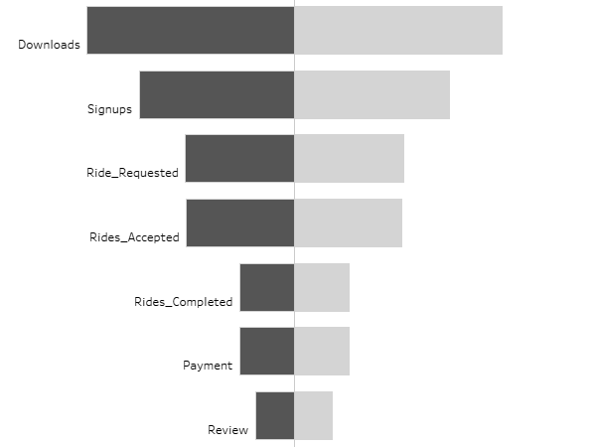
Introduction
Metrocar is a ride-sharing platform that operates as a user-friendly intermediary connecting riders and drivers through its mobile application. Its customer funnel includes the following stages:
1. App Download: A user downloads the app. 2. Signup: The user creates an account in the app 3. Request Ride: The user requests a ride. 4. Ride Acceptance: A nearby driver receives the ride request and accepts the ride. 5. Ride Completed: The driver arrives at the pickup location, and the user gets to ride to their destination. 6. Payment: After the ride, the user is charged automatically through the app. 7. Review: The user is prompted to rate their driver and leave a review of their ride experience.

Slide 3
Objective
Key Metrics
Optimize metrocar's funnel performance, enhance user satisfaction, and strengthen market position through detailed analysis and actionable recommendations for improved user engagement and revenue growth.
Download-to-signup conversion rates
Ride request acceptance rates
Completed ride rates
Payment processing efficiency
User review submissions.

Slide 4
Business Questions
What steps of the funnel should we research and improve? Are there any specific drop-off points preventing users from completing their first ride?
Metrocar currently supports 3 different platforms: IOS, android, and web. To recommend where to focus our marketing budget for the upcoming year, what insights can we make based on the platform?
What age groups perform best at each stage of our funnel? Which age group(s) likely contain our target customers?
Surge pricing is the practice of increasing the price of goods or services when there is the greatest demand for them. If we want to adopt a price-surging strategy, what does the distribution of ride requests look like throughout the day?
What part of our funnel has the lowest conversion rate? What can we do to improve this part of the funnel?

Slide 5



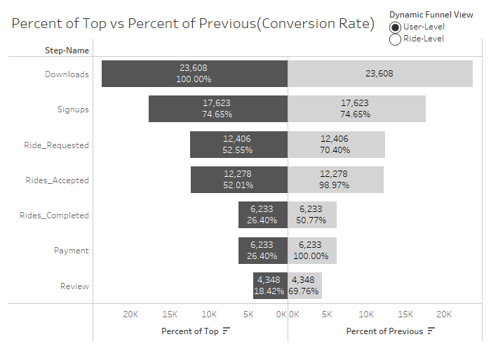
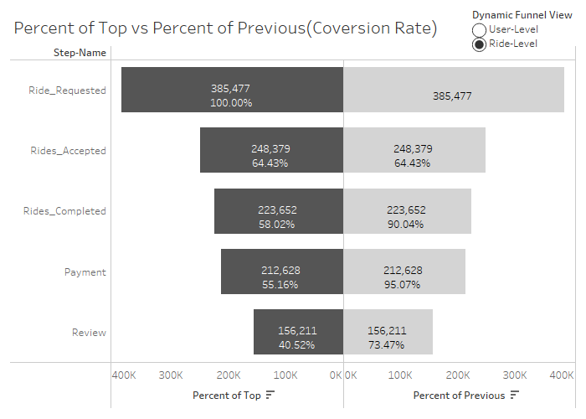
I recommend addressing the drop in the user funnel between the stage of ride accepted and completed with a drop of almost 50%, with only 6,233 user ride completed over 12,278 user ride accepted.
User Level
Ride Level
I recommend addressing the drop in the ride funnel between the stage of ride request to ride accept stage with a drop of almost 35%, with only 248,379 rides accepted over 385,477 ride requested.

Slide 6
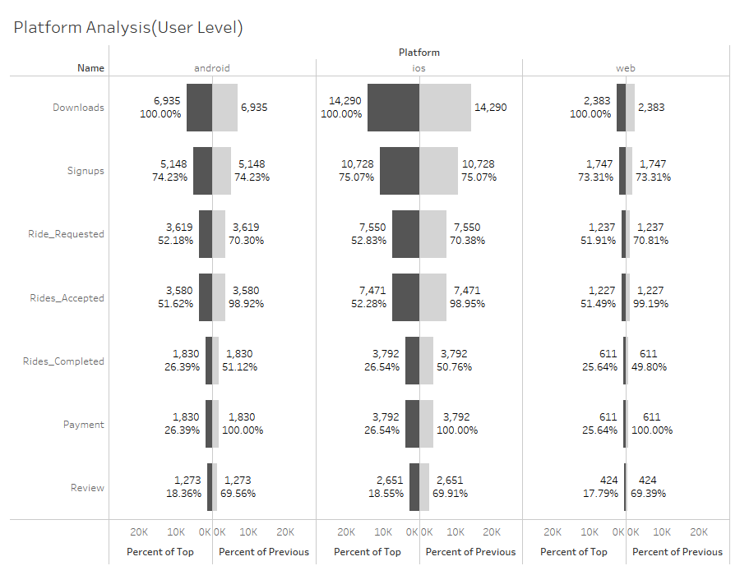
Platform Analysis(User Level)
Observation:
iOS is the best-performing platform, contributing 60.5% (14,290 users out of 23,608 users).
The web channel underperforms, contributing only 10.0% (2,383 users out of 23,608 users).
Recommendation:
Allocate the budget primarily to iOS to capitalize on its strong performance.
Reduce the budget for the web channel due to its lower contribution.
Consider reallocating the reduced web channel budget to Android, given its broader global user base (around 70%).

Slide 7
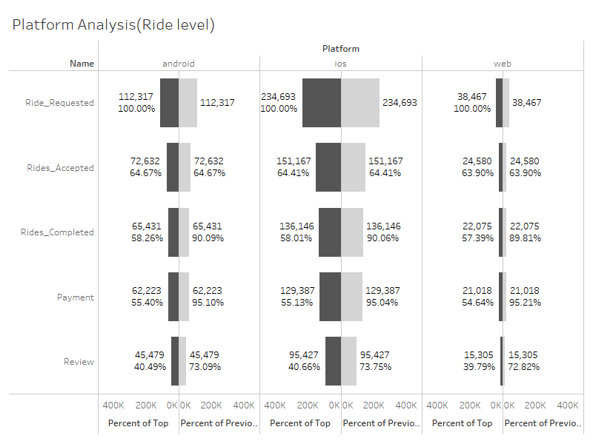
Platform Analysis(Ride Level)
Observation:
iOS is the best-performing platform, contributing 60.9% (234,693 rides out of 385,477 rides).
The web channel underperforms, contributing only 10.0% (38,647 rides out of 385,477 rides).
Recommendation:
The web channel budget should be reduced as it not only underperforms but also the app provides a more user-friendly service experience.
Allocate 55% of the marketing budget to iOS, 40% to Android to leverage its potential, and the remaining 5% to the web.

Slide 8
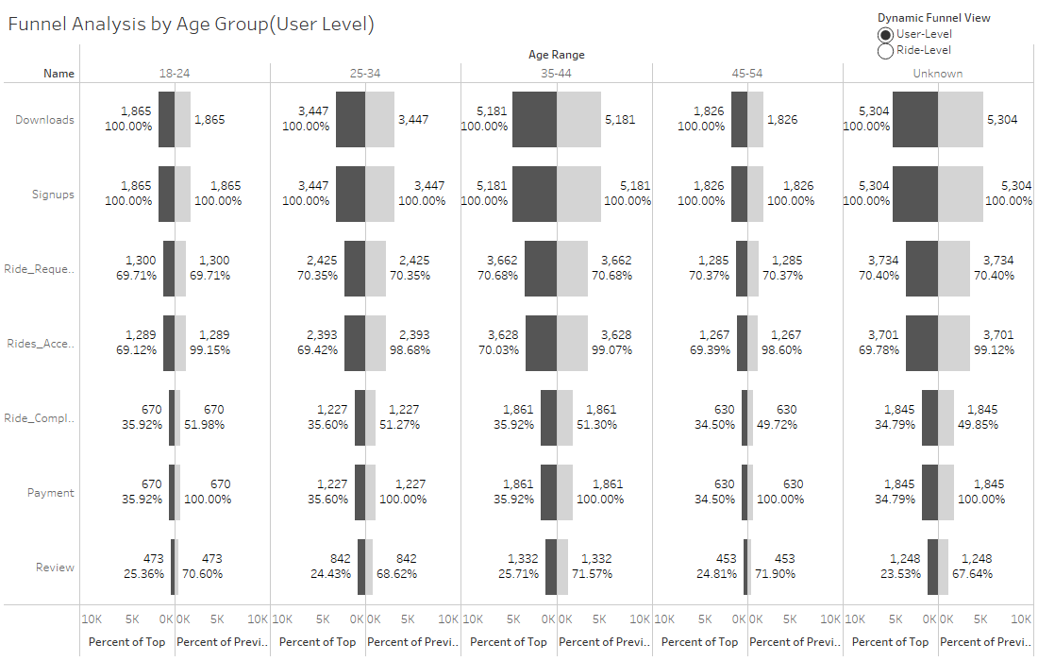
Age Group Analysis(User Level)
Observation:
The age group between 35 and 44 exhibits strong performance with approximately 5,200 users.
It's crucial to consider the 'unknown' category, where 5,300 users did not share their age, impacting the real age group distribution.
Recommendations:
Unknown: Implement a mandatory age input requirement during app download for comprehensive data collection and analysis across user groups, including the Unknown category.
Focus marketing efforts on the 25-34 and 35-44 age groups due to their strong performance.
**This chart exclude ‘Null’ Age group for clarity**

Slide 9
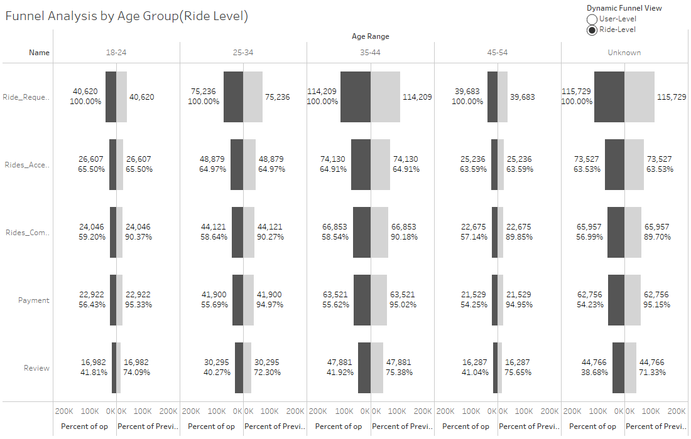
Age Group Analysis(Ride Level)
Observation:
The age group between 35 and 44 demonstrates robust performance, contributing to approximately 114,209 rides.
115,729 users in the 'unknown' category impact the real age group distribution, showing the lowest conversion rate despite the highest number of rides.
Recommendation:
Focus marketing efforts on the 25-34 and 35-44 age groups due to their significant presence and potential receptiveness.
Market research indicates 45% of users aged 18-29 and 36% aged 30-49 use ride-sharing. Implement a multi-user ride-share for users aged 25-44 to reduce cancellations and enhance satisfaction.
**This chart exclude ‘Null’ Age group for clarity**

Slide 10
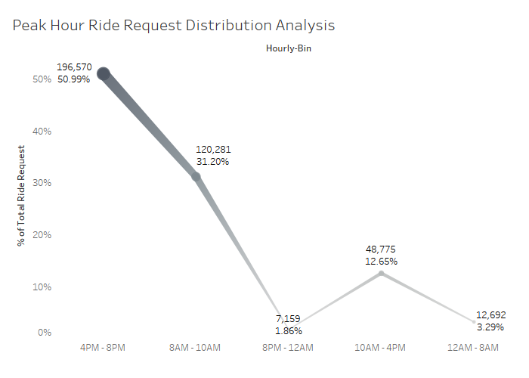
Time Distribution Analysis
Observation:
Two peak demand periods: 8 am to 10 am (51.0% of rides) and 4 pm to 8 pm (31.2% of rides) .
Surge pricing encourages more drivers during high-demand hours, balancing supply and demand.
Recommendation:
Leverage surge pricing during 4 pm to 8 pm and 8 am to 10 am to boost revenue.
Ensure an adequate supply of drivers during high-demand hours for seamless service.

Slide 11
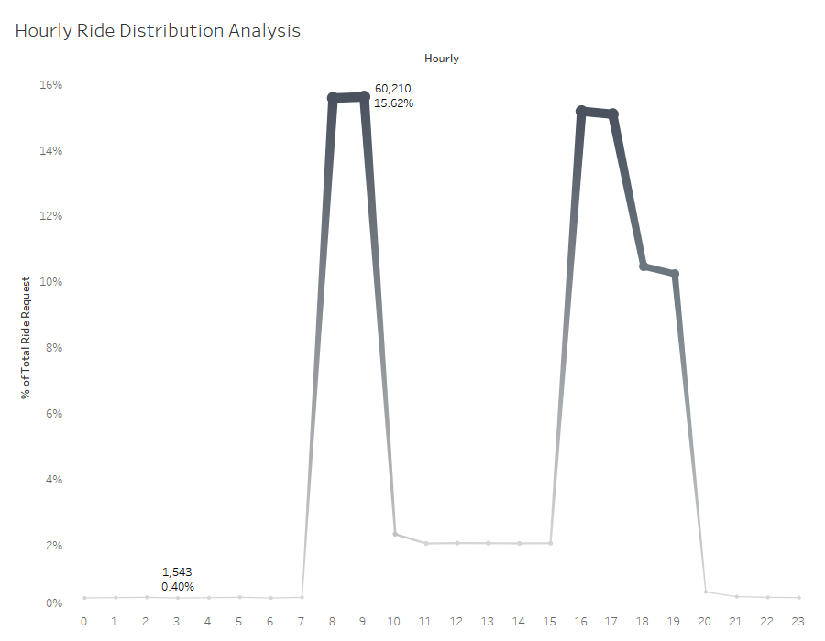
Hourly Analysis
Observation:
Peak demand during 8 am and 9 am (15.6% each of rides).
Prioritizing driver availability during peak hours is essential for optimal service.
Recommendation:
Implement incentives to attract more drivers during peak hours at 8 am and 9 am.
Optimize driver deployment strategies to ensure maximum coverage during high-demand periods.
Reduce wait times for users by enhancing driver availability during these peak hours.

Slide 12
Recommendation
User Level:
Personalize the signup process to encourage user engagement and improve the conversion rate between app downloads and signups for enhanced user acquisition.
Enhance user communication and interface to foster better engagement and improve the ride completion rate for users of all age groups.
Implement a mandatory age input requirement during the app download process to facilitate comprehensive data collection, enabling more effective and personalized marketing strategies.
Ride Level:
Implement measures to streamline the ride acceptance process and minimize drop-off rates, ensuring a seamless ride experience for users across all age groups.
Optimize driver availability during peak demand hours (8 am-10 am) to meet user needs effectively and enhance overall service satisfaction.
Strategically introduce surge pricing during peak demand periods (4 pm-8 pm) to capitalize on heightened demand and maximize revenue generation.

Slide 13
Thank You

